Slide 1
Regulation of Gene Expression in Bacteria

Slide 2
Transcription
Cells are extremely selective about which genes are expressed and in what amounts
A bacterium will sense its environment at move towards nutrients
Which genes will the bacteria need to express to break down all of these sugars to make ATP. ?
Will some genes be constitutively expressed?
Will some gene expression be regulated – turned on & off?

Slide 3
Metabolizing Lactose – A Model System
Β-galactosidase is a bacterial enzyme which is at high levels in the cell when lactose is present
Jacques Monod & Francois Jacob hypothesized the lactose might be an inducer
A molecule which can stimulate gene expression

Slide 4
Identifying the Genes Involved
Monod and Jacob preformed a genetic screen
Step 1
Generate a large pool of random mutants
X-rays, UV light, or chemicals
Step 2
Screen the mutants to find individuals with defects in the biochemical pathway you are studying

Slide 5
Replica Plating
Master Plate - Glucose
Replica Plate - Lactose
This technique ensures that the position of the bacteria is the same on both plates.
When one colony does not grow on the lactose plate but does grow on the master
plate then this colony has some biochemical defects in the metabolism of lactose.
This colony will be isolated and characterized

Slide 6
Three Distinct Types of Mutants in Lactose Metabolism of E. coli
Mutant Phenotype | Interpretation | Inferred Genotype
Cells cannot cleave indicator molecule | β-galactosidase defective | lacZ⁻
Lactose does not accumulate inside cells | Membrane protein for transport defective (galactoside permease) | lacY⁻
Indicator molecule is cleaved even if lactose is absent | Constitutive expression of lacZ⁻ and lacY⁻ Regulatory gene is defective. | lacI⁻

Slide 7
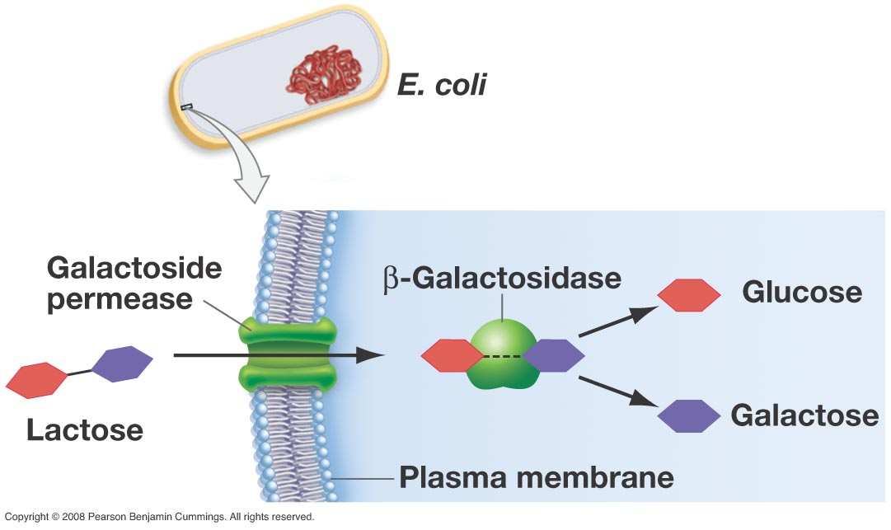
Critical Proteins for Lactose Metabolism

Slide 8
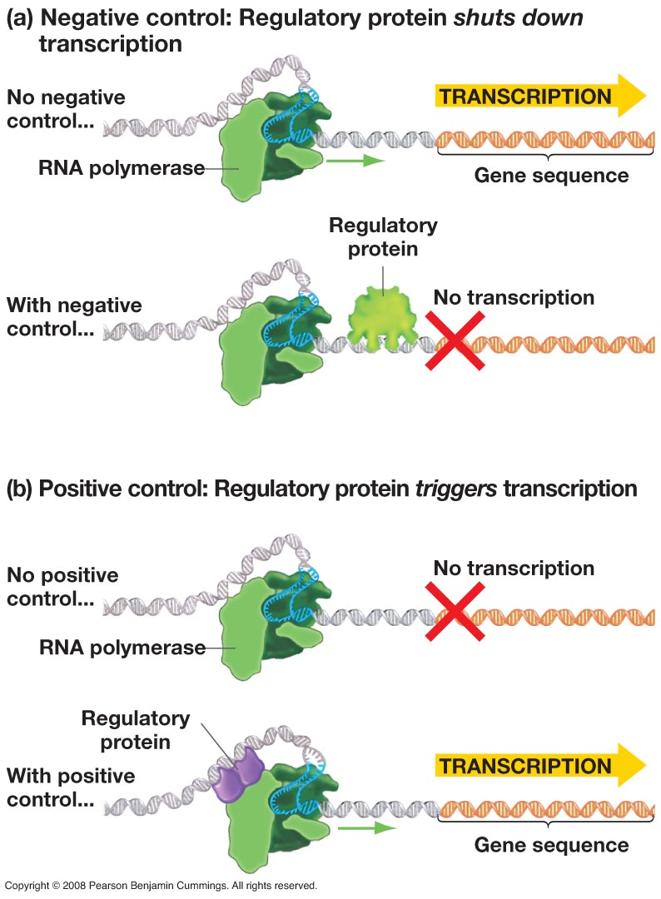
Transcription Regulation
Repression
Transcription factors and regulatory proteins bind to DNA and block transcription
Induction
Transcription factors and regulatory proteins bind to DNA and allow transcription

Slide 9
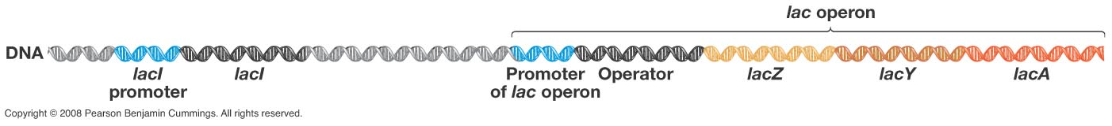
The lac Operon
Jacob and Monod summarized their results in 1961 with a comprehensive model of negative control
They coined the term operon for a set of coordinately regulated bacterial genes that are transcribed together into one mRNA
Polycistronic mRNA

Slide 10
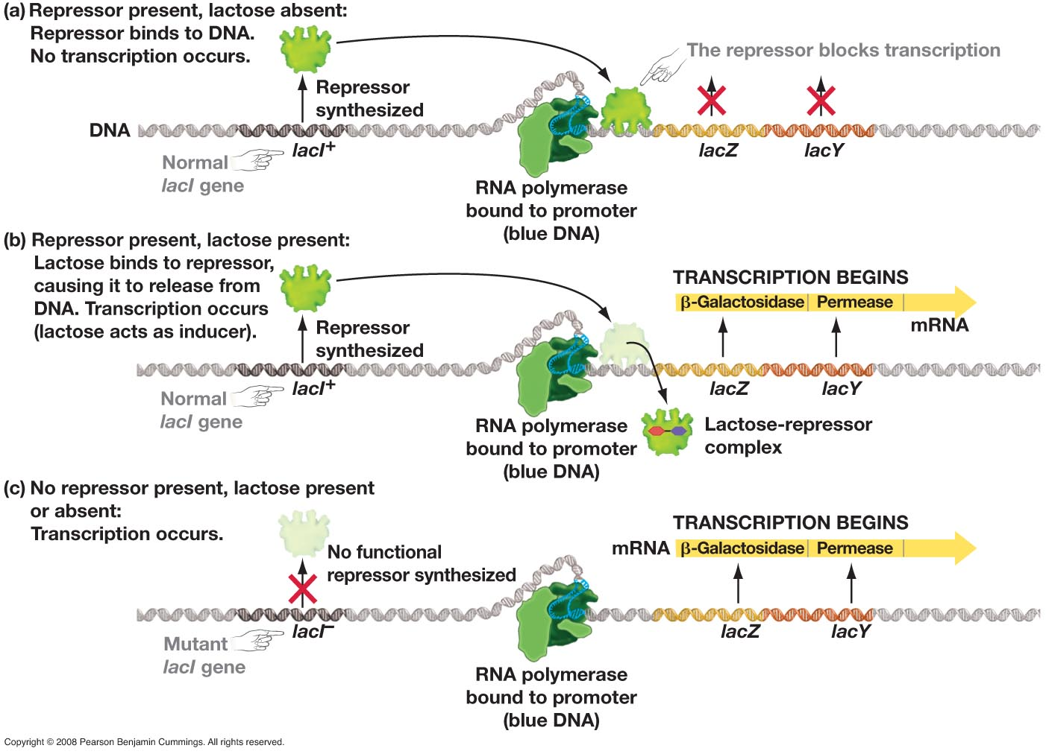

Slide 11
The Jacob-Monod Model
lacZ, lacY, and lacA genes are adjacent and are transcribed into one mRNA initiated from a single promoter
Coordinated gene expression
Repressor protein is encoded by lacI, binds to operator and prevents transcription of lacZ, lacY and lacA
lacI is expressed constitutively
Lactose is the inducer and binds to repressor
Allosteric regulation of repressor

Slide 12
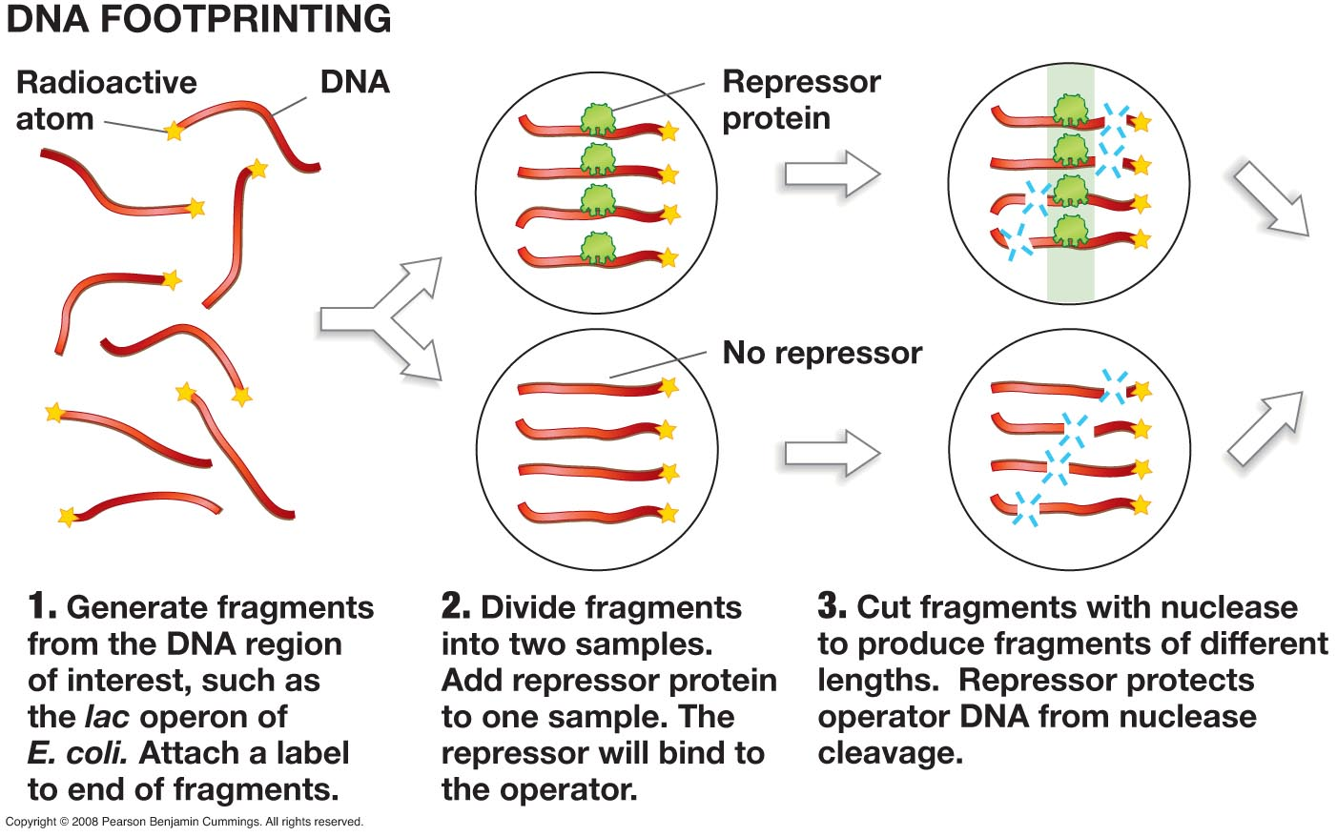
DNA Footprinting
In 1967, six years after the Jacob and Monod paper Walter Gilbert confirmed
the hypothesis of Jacob and Monod by fully characterizing the operator

Slide 13
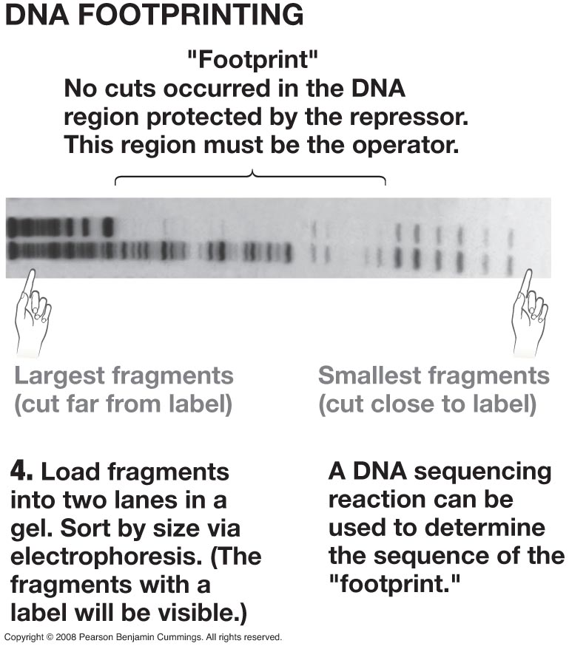
DNA Footprinting
These experiments showed that the repressor interacted physically with the DNA sequences of the operator
The operator was not a protein or a mRNA molecule

Slide 14
Importance of lac operon
Confirmed the presence of regulatory sequences of DNA
Confirmed the presence of regulatory DNA binding proteins
Post translational modification (binding of lactose to an existing protein)-the activity of existing protein is altered as the environment changes.

Slide 15
Other Operons
The lac operon system is an inducible system
This means that the genes under control of this promoter are always “OFF” and must be regulated “ON”
Many other genes in E. coli are regulated by an inducible system
However further work has shown that repressible systems also exist in E. coli
This means that the genes under control of this promoter are always “ON” and must be regulated “OFF”

Slide 16
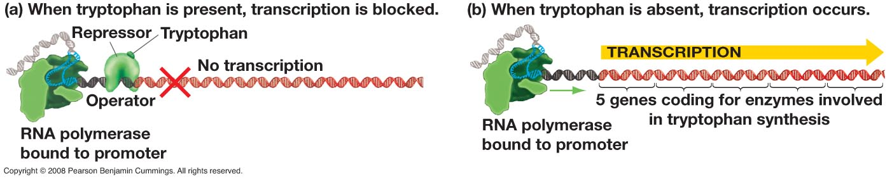
trp Operon
The trp operon codes for an enzymes needed for the synthesis of tryptophan
This is an anabolic pathway as opposed to the catabolic pathway for the lac operon
Bacterial cells should have the trp operon “ON” in the absence of tryptophan and “OFF” in the presence of tryptophan

Slide 17
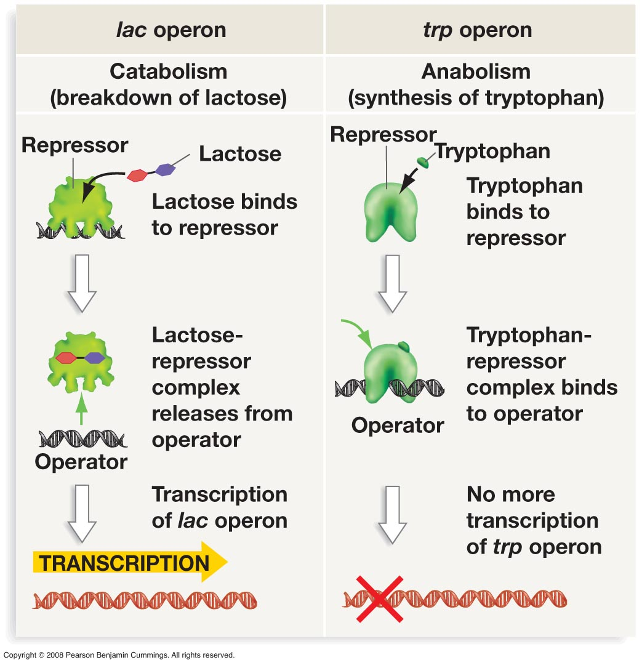

Slide 18
Catabolite Repression
Glucose is the preferred fuel source for bacterial cells
In the presence of both glucose and lactose very little β-galactosidase is present
How can this result be explained?
Lactose is present so the repressor is not bound to the operator transcription should occur?

Slide 19
Promoter Strength
Not all promoters are created equal
Strong promoters
RNA polymerase and sigma strongly bind to promoter and initiate transcription without additional factors
Weak promoters
Additional factors are necessary to for the promoter to strongly bind to RNA polymerase

Slide 20
lac Promoter
lac promoter is a weak promoter
lac promoter has an additional regulatory DNA sequence known as the CAP binding site
Catabolite activator protein
CAP binding greatly increases the strength of the lac promoter
CAP can only bind when its allosteric molecule cAMP is present
How this all works ??????

Slide 21
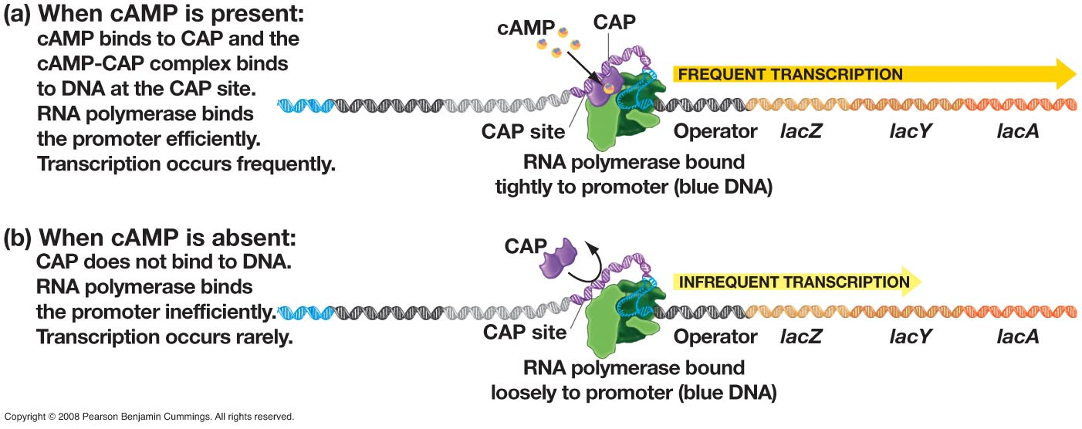
But how does a bacteria cell decide when to make cAMP?

Slide 22
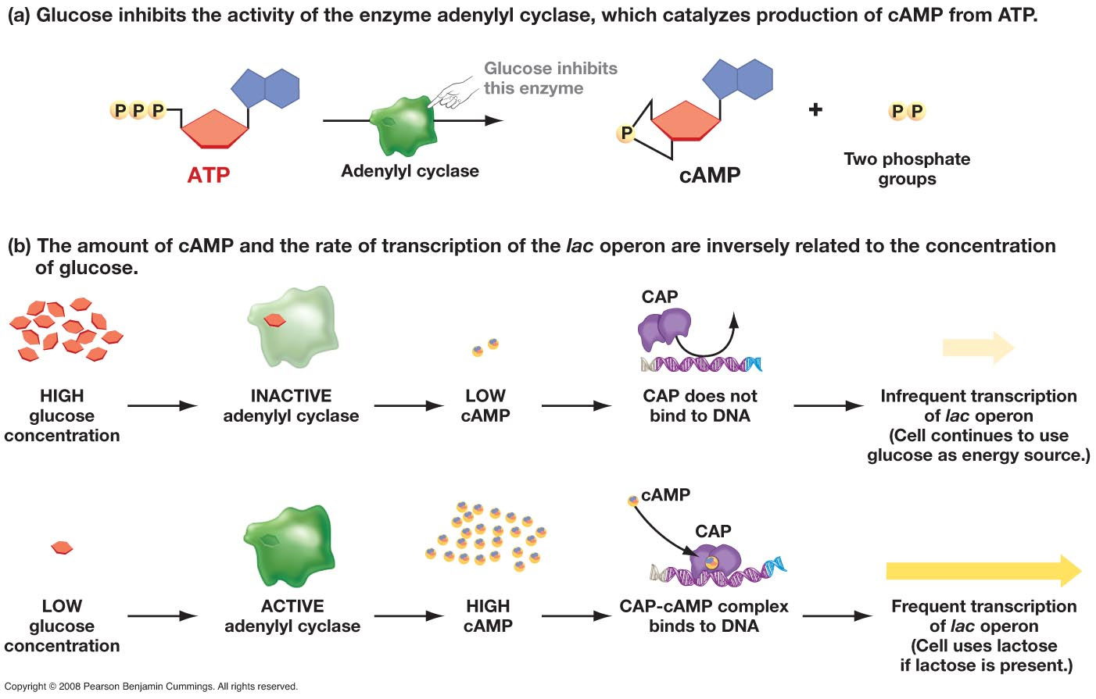
Blocking Production of cAMP
In the original example the bacteria has many sugars to choose from.
Glucose is known to be the fuel source of choice. Under these conditions
glucose levels outside the cell will bind to adenylyl cyclase and inhibit this
enzyme from making cAMP.
AC

Slide 23
Production of cAMP
However, if environmental conditions change then no glucose will bind to
adenylyl cyclase. Therefore, cAMP levels will increase and if lactose is
Present the lac operon will be turned “ON”. However, if no lactose is present
The repressor will still be bound to the operator an no transcription will occur.
AC

Slide 24
CAP-cAMP system influences many genes in addition to the lac operon.
Cap sites are found adjacent to the promoters for several operons that are
required for the metabolism of sugars other than glucose

Slide 25
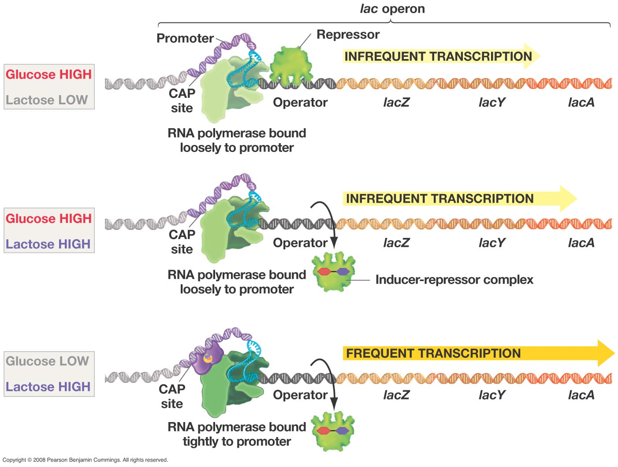

Slide 26
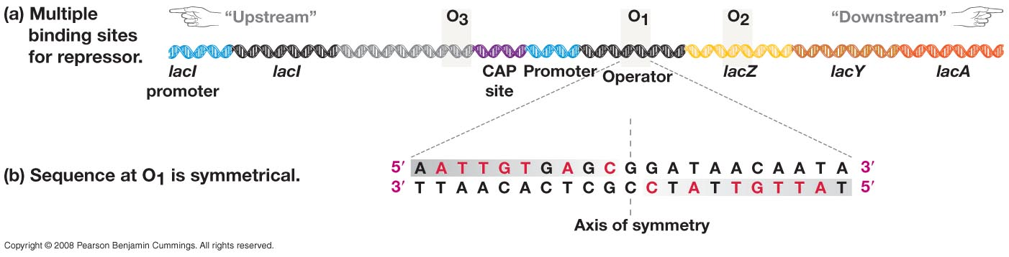
Characterization of the Operator
The sequences of many DNA regulatory elements have dyad symmetry
These sequences are now known to interact with specific amino acid sequences in the DNA binding protein

Slide 27
Characterization of DNA Binding Proteins
Most DNA binding proteins have distinct domains which are characterized by specific motifs
Each domain has a specific job
Bind to DNA
Bind to inducer
Each motif is a specific 3D structure
Helix turn helix
Leucine zipper
Barrel motif

Slide 28
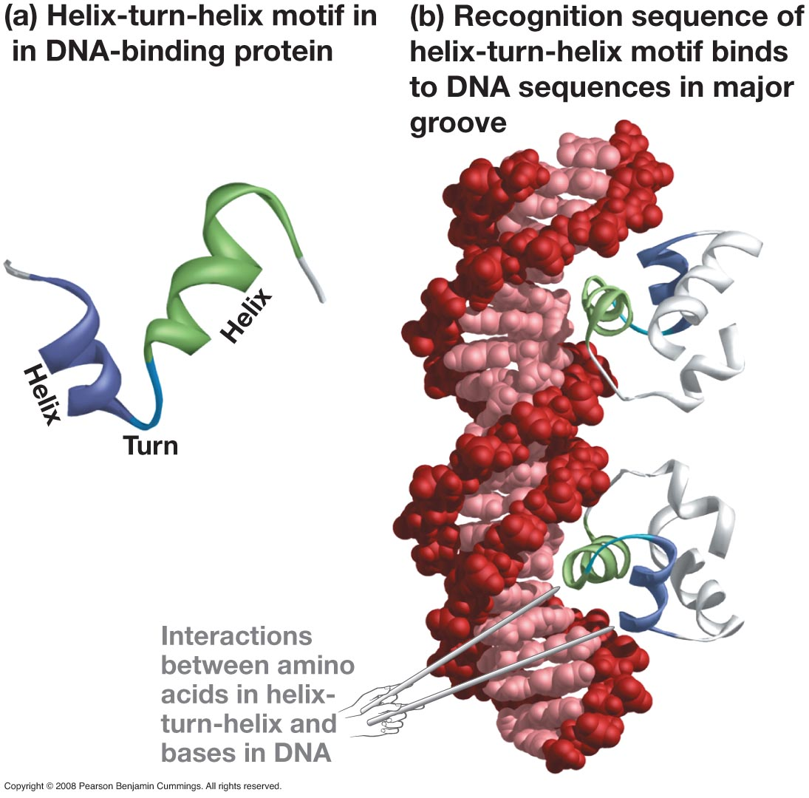
Helix Turn Helix
One helix interacts with sugar phosphate backbone
One helix interacts with base pairs in the major groove
Recognition sequence

Slide 29
Recognition Sequence
The amino acid sequences of recognition sequences vary
Each regulatory protein has a unique recognition sequence and a unique regulatory sequence of DNA
As with many DNA regulatory proteins, binding of the allosteric molecule causes a conformational change in structure
Cause the protein to bind
Cause the protein to fall off

Slide 30
